Slide 1
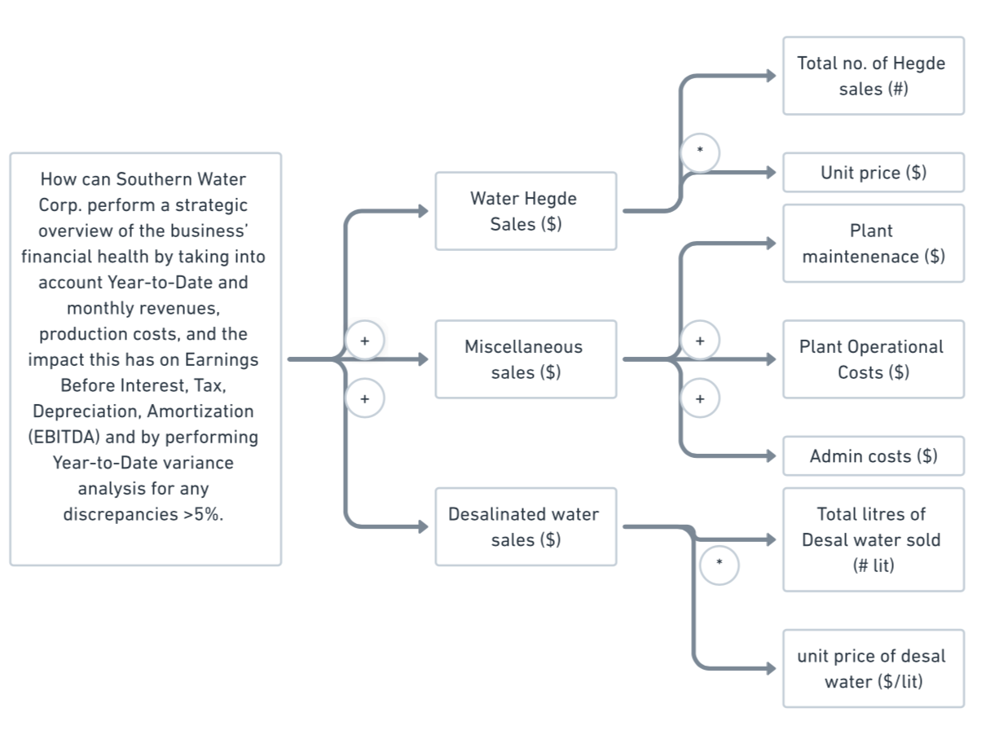
STRUCTURED FOUNDATIONS
Value Driver Tree Template

